Slide 1
UNIT
DAY 1
0
INTRO TO DIGITAL DESIGN
AGENDA
REMINDERS
Put your phones into The Holding Cell
What is Design?
The Design Cycle
Assessment This Year
Classroom Expectations
AI & Late Work Policy
The Five Laws of Codecraft
Units for this Year
Where to Find Materials
Contacting Me

Slide 2

WHAT IS DESIGN?
Per the IB:
Design is the link between innovation and creativity, taking thoughts and exploring the possibilities and constraints associated with products or systems, allowing them to redefine and manage the generation of further thought through prototyping, experimentation, and adaptation. It is human-centered and focuses on the needs, wants, and limitations of the user.
As designers, we:
Adapt approaches to different situations
Have responsibilities to the community and the environment
Maintain unbiased views on situations and evaluate objectively
Have good communication
Are creative, imaginative, knowledgeable, researchers, investigators, problem solvers

Slide 3
WHAT IS DESIGN?
This is a digital design class, meaning our work will take place on computers, mostly
We’ll be exploring a variety of computing topics, while also using traditional design skills

Slide 4
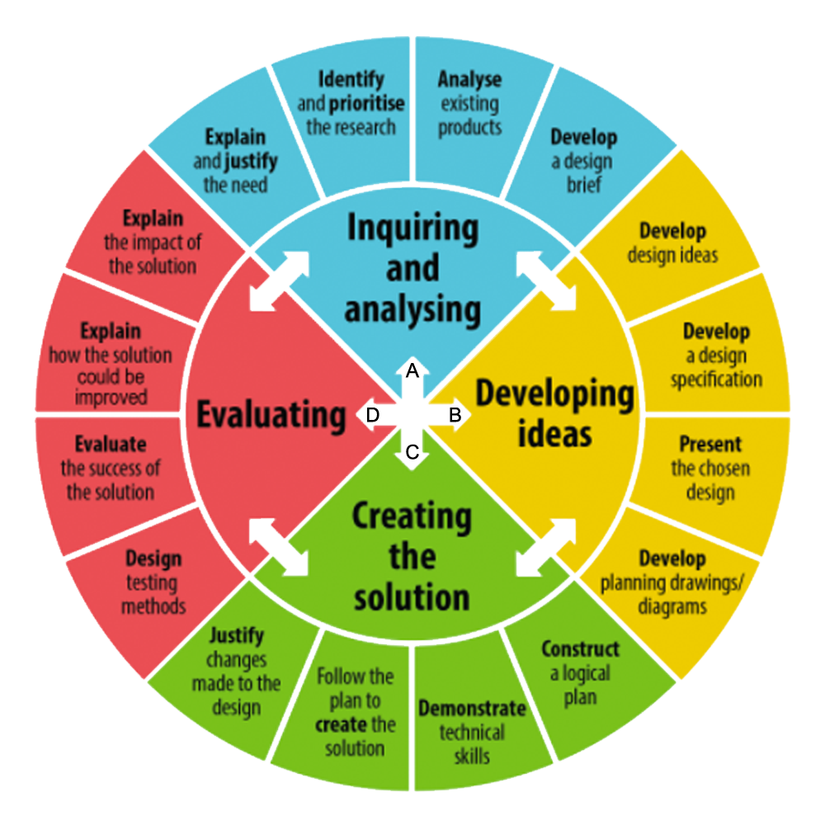
THE DESIGN CYCLE
I’m sure, by now, you’ve all seen the design cycle
As opposed to something like the scientific method, the design cycle lets you go back and forth between steps whenever you please, if it’s in the best interest of your designing process
We’ll be touching on every part of the design cycle many times in the upcoming year while we learn our tools

Slide 5
ASSESSMENT THIS YEAR
Assessment will be done using the 4 sectors of the design cycle
Criteria A – Inquiring and Analyzing
Criteria B – Developing Ideas
Criteria C – Creating the Solution
Criteria D – Evaluating
Each quarter will hold a summative design project where you’ll be assessed on most, or all, of these criteria
In-between those projects, we’ll be developing skills formatively, doing lessons, labs, and activities
This means that your projects are each very large components of your grade

Slide 6
ASSESSMENT THIS YEAR
We’ll get more into the specifics on assessments when we actually have some, but if you have any questions, please don’t hesitate to reach out to me

Slide 7

CLASSROOM EXPECTATIONS
NO PHONES!

Slide 8

CLASSROOM EXPECTATIONS
Phones are to be kept in the The Holding Cell unless explicitly directed, or permission is asked for and given
You may listen to music using your phone during independent work time, but it might be easier for you if you link your earbuds to your PC instead fwiw
No playing games on your laptops
You can go to the restroom at any time, just ask
Active engagement, collaboration, discussion with classmates

Slide 9


AI & LATE WORK POLICY
AI usage and plagiarism:
AI Generation or plagiarism of any work submitted directly to me or the IB is prohibited
AI can be used sparingly for research and thought organization
I would encourage you to avoid this as much as possible, given that we are trying to develop these skills as part of the design process
Work will be analyzed carefully by me, and if I suspect it is AI generated or plagiarized, we will have a ‘chat’
Possible consequences include
Being asked to entirely re-do your work
A whole, full fat 0
A chat with the higher-ups

Slide 10
AI & LATE WORK POLICY
AI usage and plagiarism:
We all know that AI is an incredibly useful tool
Our goal is to use AI to deepen our knowledge and skills, not to offload them
If you want to use AI, and have a question about if your usage of AI will be allowed or not, please email me or speak with me directly

Slide 11

AI & LATE WORK POLICY
Late work:
Late work suffers a full mark deduction of 1 every day that an assignment is failed to be submitted
Note: if your work is incomplete, but has some complete criteria, submit the complete part for me to grade as ‘not late’ and the rest whenever you finish it
This means that after a week, you won’t get any credit
You will be given ample time in class to complete your work
If there is some circumstance where you need additional time, speak with me at least 48 hours or more before the deadline to be considered for an extension

Slide 12

FIVE LAWS
OF
CODECRAFT
AI & LATE WORK POLICY
Late work:
In the event of an emergency-emergency (family, health), please let me know as soon as you can and I will likely grant you an extension
These are the things in life that matter much more than computers lol
If you are out sick on a presentation day, please let me know so you can present during the next period
If you are going on a trip during our working period, please let me know as soon as you can so I can let you know how to be prepared for when you get back

Slide 13
THE FIVE LAWS OF CODECRAFT
The Five Laws of Codecraft are a set of laws governing the good authorship of code. Failure to adhere to the great Five Laws of Codecraft wil result in marks deductions (specifically on criteria C – generally)
Now, just what are these laws you may be wondering?

Slide 14
1.
1.
COMMENT WITH PURPOSE
Thy must comment your code. Let your comments illuminate, not obscure, the journey of your logic.

Slide 15
2.
RESPECT THE NAMING OF VARIABLES
Let the names of variables reflect the nature of variables, so others may follow with ease.

Slide 16
3.
REFRAIN FROM REPETITION
Code once, reuse endlessly. Loops, functions, and objects are your allies in the field.

Slide 17
4.
CITE THY SOURCES WITH HONOR
If thou borrows from the knowledge of others, give credit where it is due, for integrity in code reflects integrity in character.

Slide 18
5.
EMBRACE FAILURE AS KNOWLEDGE
Errors are teachers in disguise; debug with patience and wisdom.

Slide 19
UNITS FOR THIS YEAR
These are all tentative, but currently these are the plans
UNIT 1: Games of Logic - 8/26-10/13
Creating a card/board game based on a fundamental computer science principle
Topics include: binary, hexadecimal, logic gates, data representation, truth tables, assembly language
UNIT 2: Built to Order - 10/15-1/22
Solving a repetitive task of a peer or other client using a Python program
Topics include: Python, input/output, data types, variables, operators, arithmetic, casting, conditionals, loops, debugging, strings, lists, dictionaries, functions, file input/output, tkinter

Slide 20
UNITS FOR THIS YEAR
UNIT 3: Frame Perfect – 1/28-3/9
Your choice between
Sequencing a video-game tool assisted speedrun of at least 60 seconds
OR
Sequencing a song (original or cover) using the original Nintendo’s sound chip
Topics include: Constraint identification, scripted playback, sequenced data structures, technical implementation, reproducability
UNIT 4: Open Problem – 3/24-5/12
Your capstone project – identify a problem faced by a larger group of people, collect data using a survey, solve it using a Python program, and solicit feedback from a group of testers

Slide 21
WHERE TO FIND MATERIALS
Pretty much everything you see during this class will be available under the classroom GitHub page
GitHub is an industry standard tool used for organizing projects, often called ‘version control’
For us, it’s a shared folder I can use so you can go back to lessons, find assignments, etc. at any time
JAEOStudios/MYP-Digital-Design

Slide 22
CONTACTING ME
You can reach me at michael.hill@students.alcuinschool.org
I’m typically available until 10PM, and I’m willing to do my best to answer question until then
If you’ve got a particularly complex problem, I might have to wait for a work day so I can look over it on my computer
Please try to research and/or debug before immediately emailing me
This helps both of us, because you’ll be able to learn how to solve your problems better
If you’d like in-person help, please email me first to make sure I’m available before coming to get help
I’m generally available M-F from 8:00-8:30, and every day from 1:30-3:00. You can also come ask questions on M/T/W during E-period, and from 4:00-4:30 every day

